Slide 1

ANALOGY OF POINT FEATURE EXTRACTION TECHNIQUES
Authors
A Velayudhan
Nandakishore R Nair
Neeraj S
VIshnu S
Mentor : Mr Vivek A

Slide 2
Abstract
Image processing is a significant section of robotic and machine learning. The field of image processing is significant in terms of usage in the advanced world ranging from security, facial recognition to remote autonomous terrain mapping. The salient problem in image processing is how to detect, identify and recognise the feature points in an image. However, there are numerous feature point extraction techniques. In this paper, we are comparing the different available point feature extraction techniques currently in existence based on the scale changes, noise, rotation etc. The evaluation is based on the number of feature points from the reference image as well as matched points in the wild frame and elapsed time

Slide 3
Objective
The focal point of the experiments was to estimate the best point feature extraction techniques based on the following parameters :
Time of feature extraction
Number of feature points
Time for cross matching

Slide 4
An experiment was conducted for the cross comparison of the various available feature extraction algorithm namely,
BRISK
FAST
HARRIS
KAZE
MINEIGEN
MSER
ORB
SURF
The parameters considered for the cross comparison were Time taken for feature extraction and number of match points detected and the test was conducted by introducing effects and distortions like rotation, scale change and noise.

Slide 5
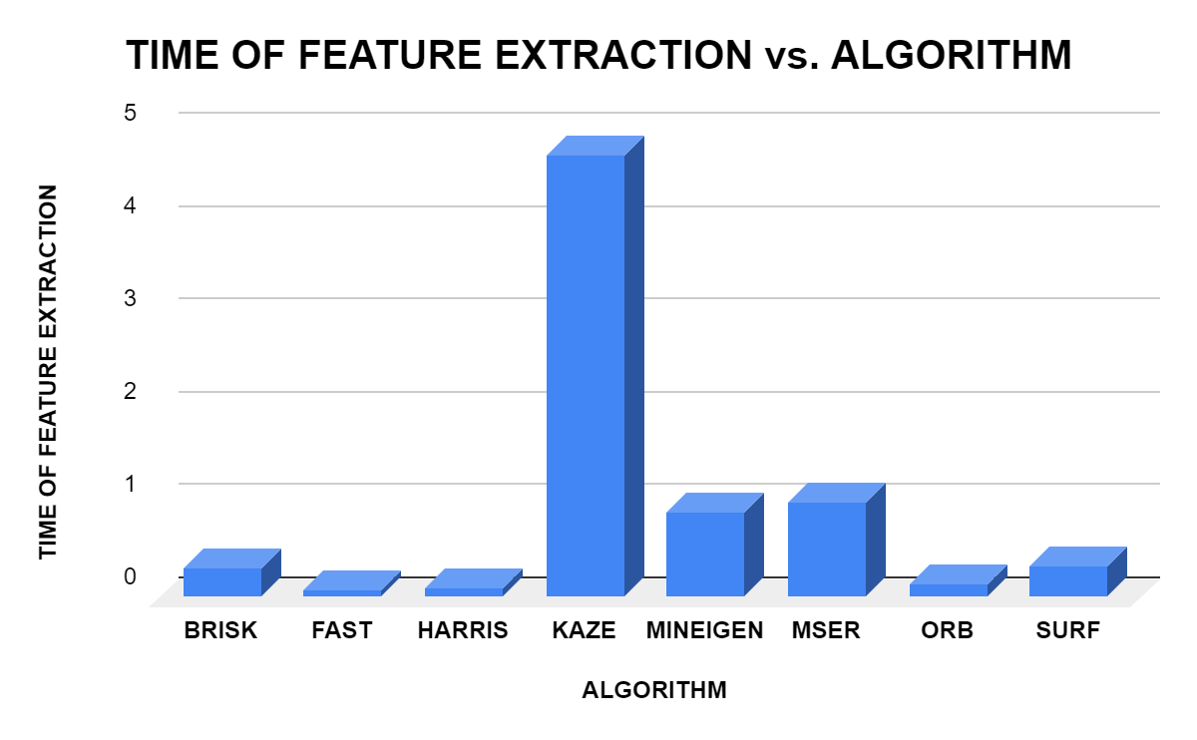
Time of feature extraction
This section tabulates the time required for feature extraction of each point feature extraction methods namely BRISK, FAST, HARRIS, KAZE, MINEIGEN, MSER, ORB, SURF.
ALGORITHM | TIME OF FEATURE EXTRACTION
BRISK | 0.313587
FAST | 0.074147
HARRIS | 0.0853465
KAZE | 4.763558
MINEIGEN | 0.91857
MSER | 1.010411
ORB | 0.148321
SURF | 0.334866

Slide 6
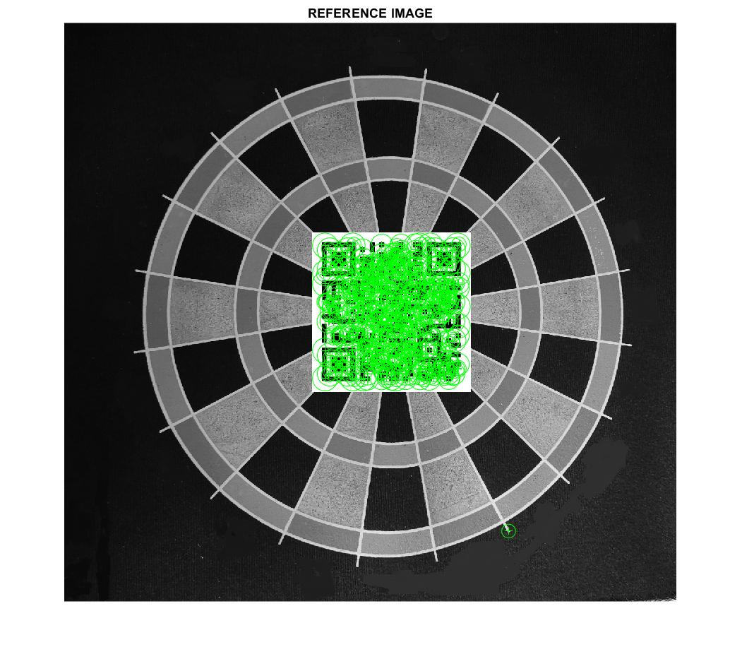
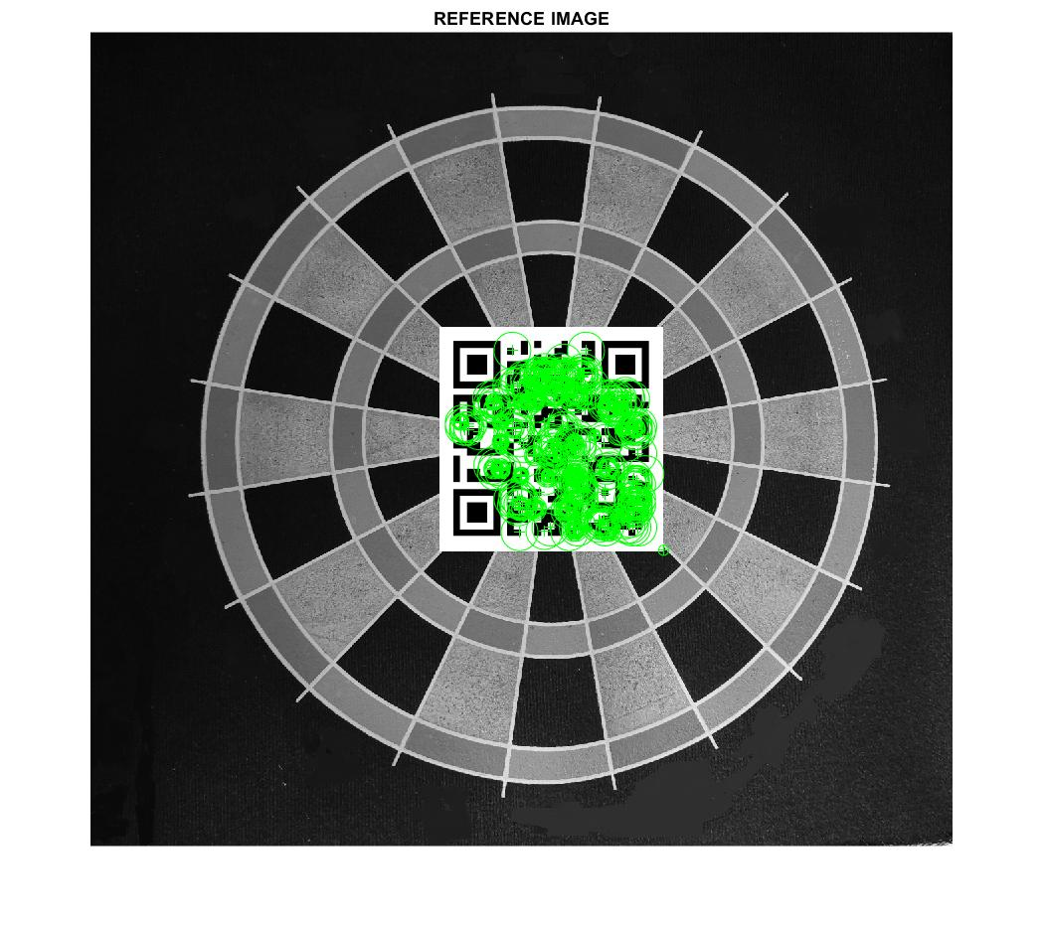
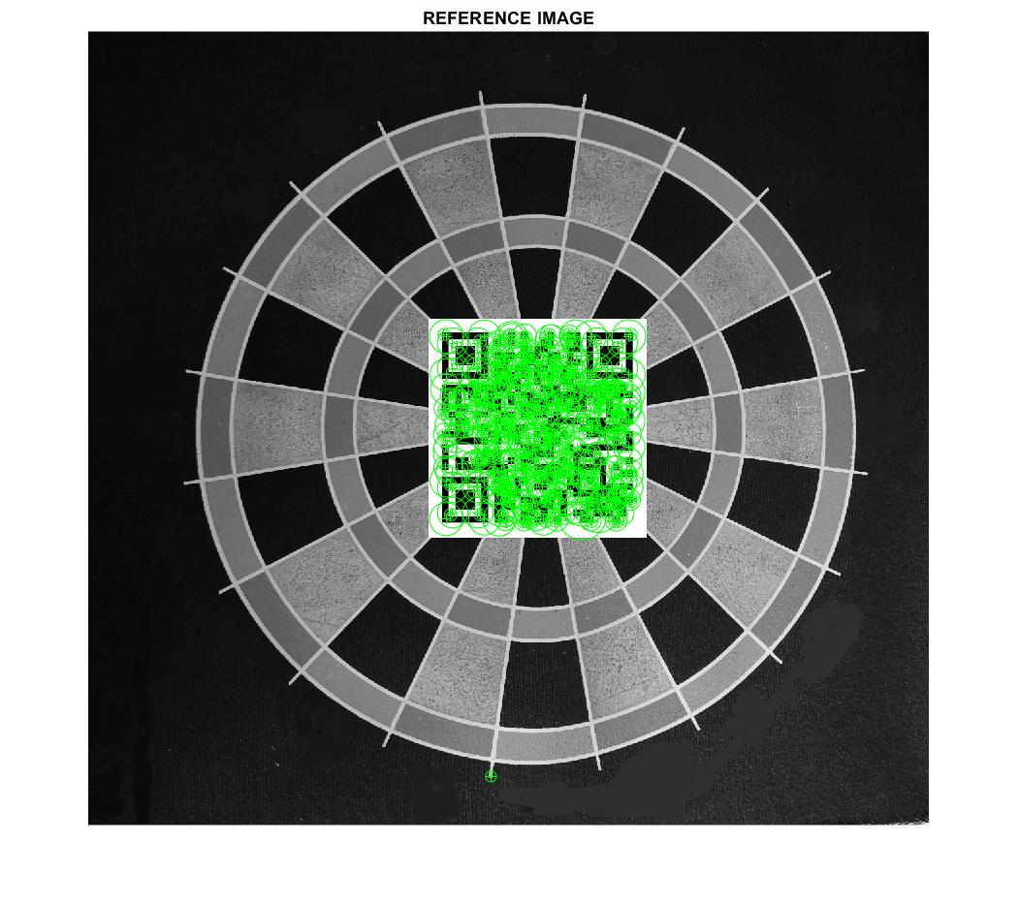
Extracted feature points using different methods
Feature extraction using KAZE method
Feature extraction using ORB method
Feature extraction using SURF method

Slide 7
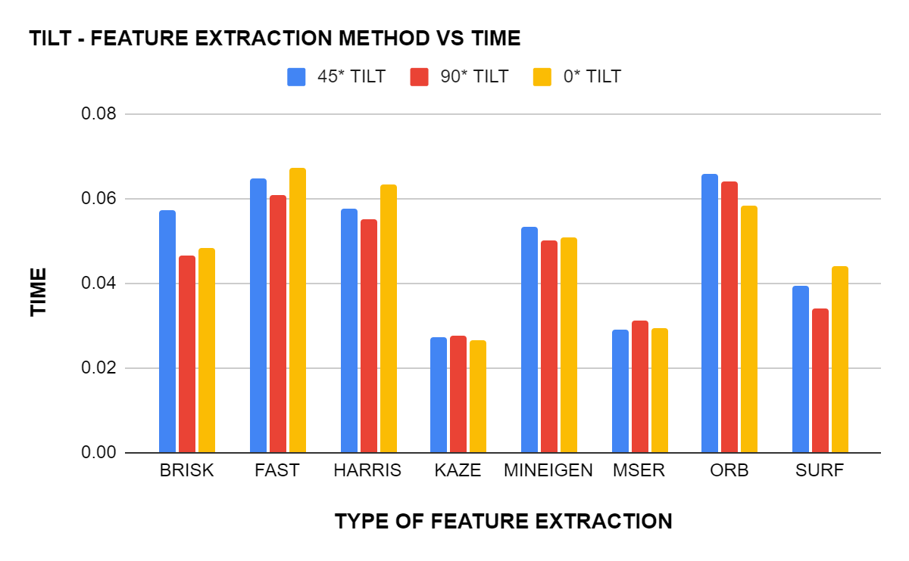
TILT - FEATURE EXTRACTION METHOD VS TIME
TILT - FEATURE EXTRACTION METHOD VS TIME
ALGORITHM/TILT ANGLE | 45* TILT | 90* TILT | 0* TILT
BRISK | 0.057429 | 0.046397 | 0.048213
FAST | 0.064922 | 0.060837 | 0.067189
HARRIS | 0.057784 | 0.055006 | 0.063457
KAZE | 0.02712 | 0.027696 | 0.026556
MINEIGEN | 0.053279 | 0.050198 | 0.05072
MSER | 0.029002 | 0.031249 | 0.029311
ORB | 0.06573 | 0.064043 | 0.05838
SURF | 0.039339 | 0.03423 | 0.044163

Slide 8
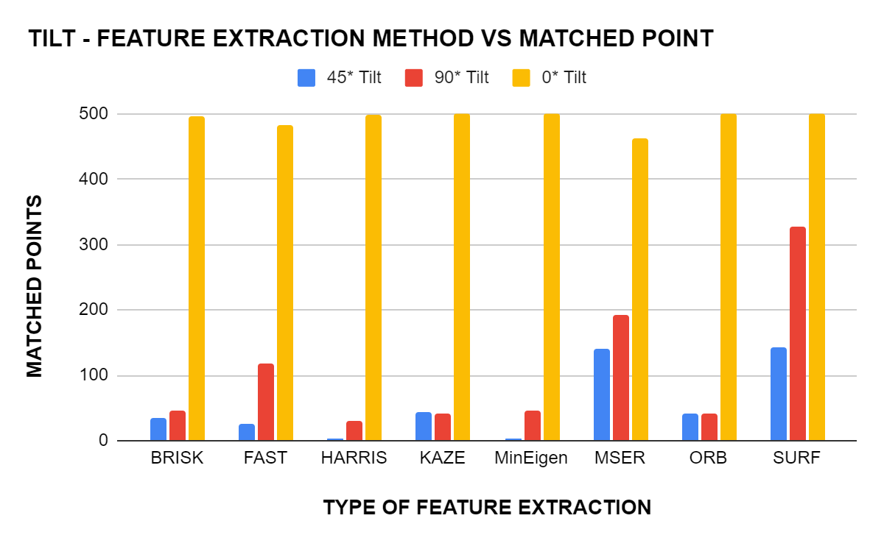
TILT - FEATURE EXTRACTION METHOD VS MATCHED POINT
TILT - FEATURE EXTRACTION METHOD VS MATCHED POINT
Algorithm | 45* Tilt | 90* Tilt | 0* Tilt
BRISK | 35 | 47 | 496
FAST | 25 | 118 | 483
HARRIS | 3 | 31 | 498
KAZE | 44 | 41 | 500
MinEigen | 3 | 46 | 500
MSER | 140 | 193 | 463
ORB | 41 | 41 | 500
SURF | 142 | 327 | 500

Slide 9
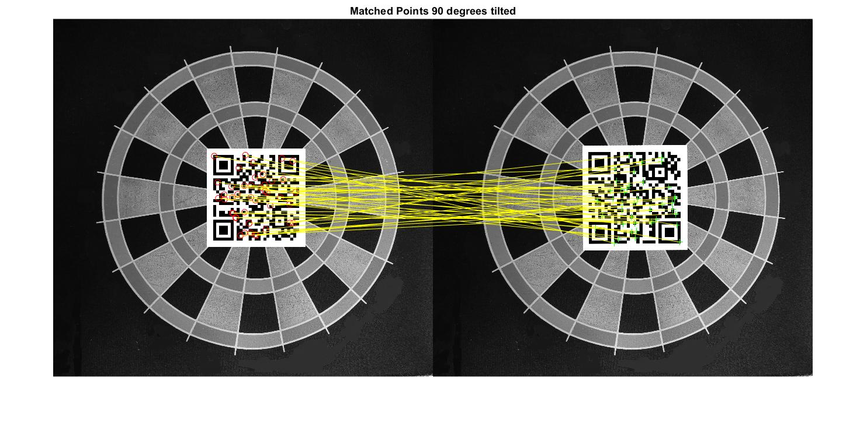
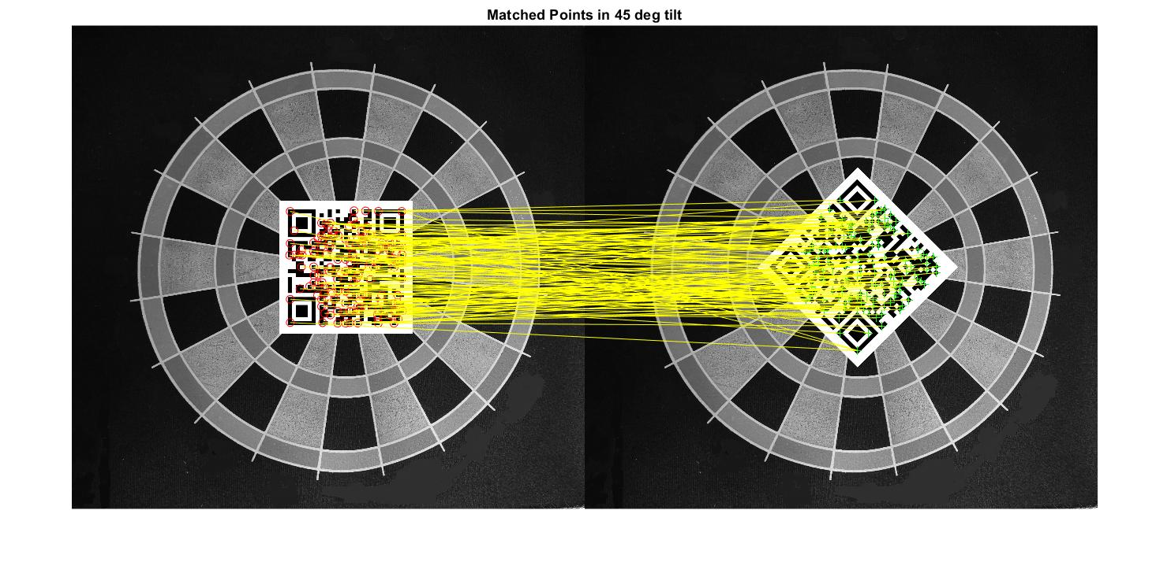
Feature point cross matching using BRISK method at a tilt of 90 degree
Feature point cross matching using SURF method at a tilt of 45 degree

Slide 10
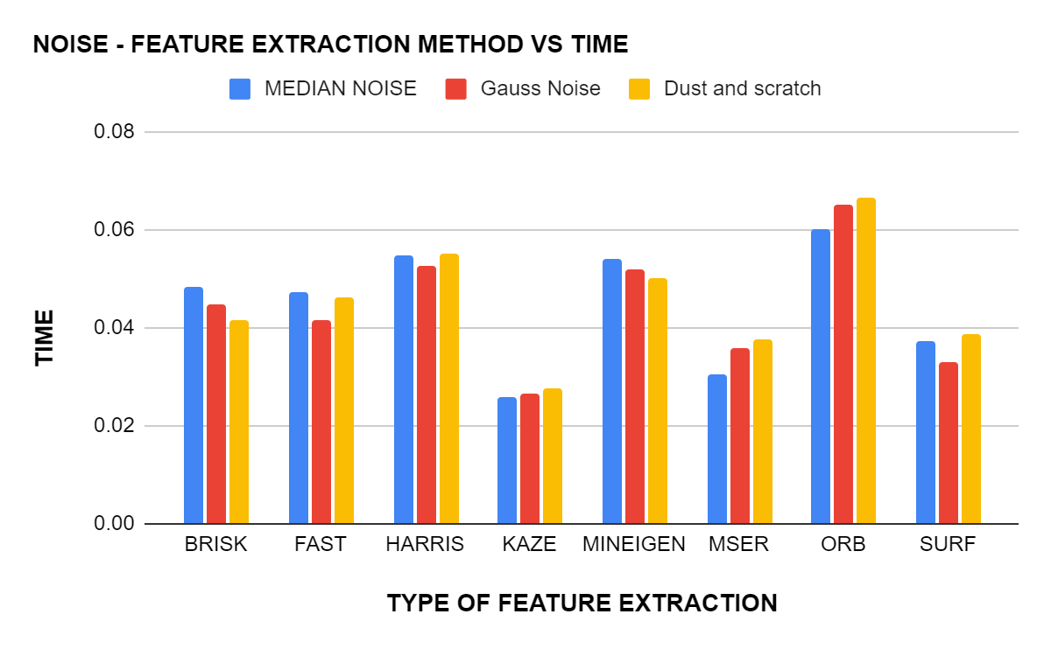
NOISE - FEATURE EXTRACTION METHOD VS TIME
NOISE - FEATURE EXTRACTION METHOD VS TIME
ALGORITHM | MEDIAN NOISE | Gauss Noise | Dust and scratch
BRISK | 0.048426 | 0.044872 | 0.041388
FAST | 0.047351 | 0.041478 | 0.04614
HARRIS | 0.054686 | 0.05249 | 0.05528
KAZE | 0.025917 | 0.026505 | 0.027484
MINEIGEN | 0.054124 | 0.051961 | 0.050279
MSER | 0.030573 | 0.035674 | 0.037759
ORB | 0.060046 | 0.065243 | 0.066454
SURF | 0.037223 | 0.033108 | 0.038761

Slide 11
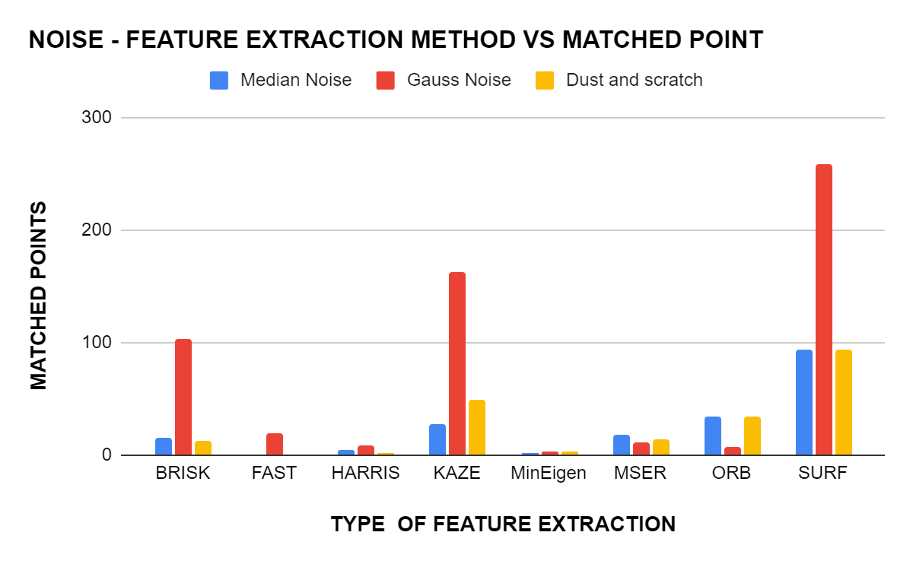
NOISE - FEATURE EXTRACTION METHOD VS MATCHED POINT
NOISE - FEATURE EXTRACTION METHOD VS MATCHED POINT
Algorithm | Median Noise | Gauss Noise | Dust and scratch
BRISK | 15 | 103 | 13
FAST | 0 | 20 | 1
HARRIS | 4 | 9 | 2
KAZE | 28 | 162 | 49
MinEigen | 2 | 3 | 3
MSER | 18 | 12 | 14
ORB | 34 | 8 | 34
SURF | 94 | 259 | 94

Slide 12
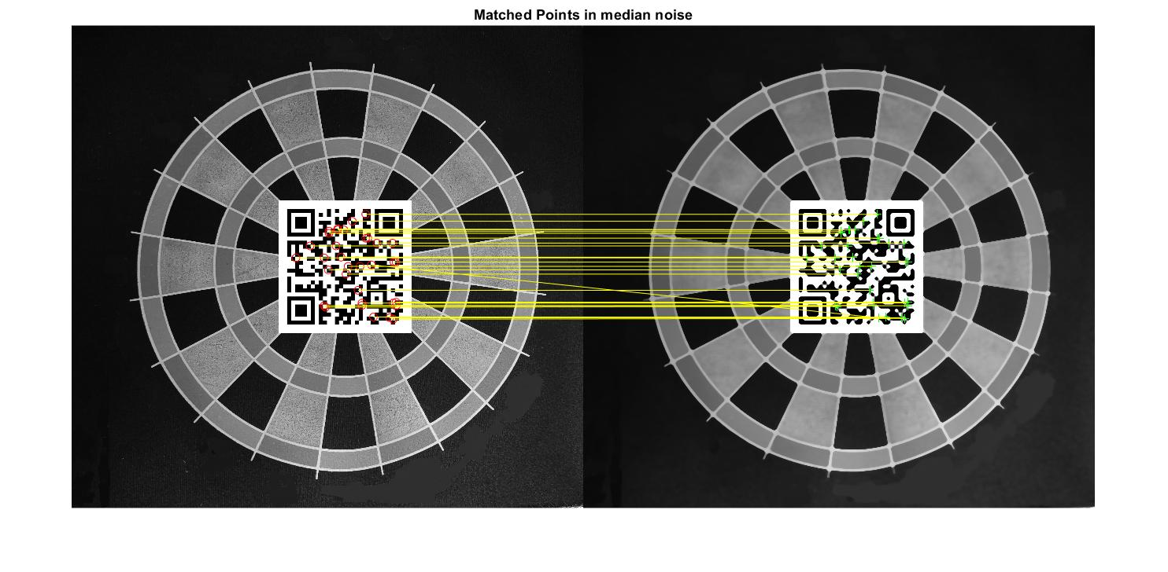
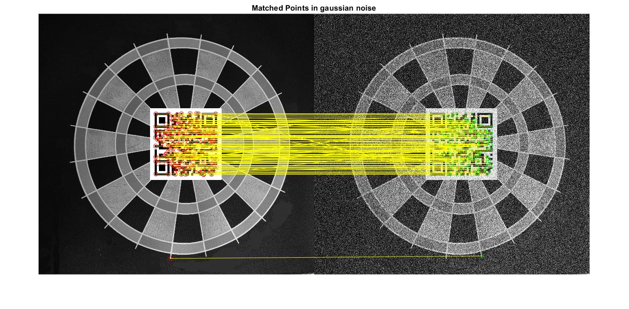
Feature point cross matching using ORB method for median noise
Feature point cross matching using SURF method for gaussian noise

Slide 13
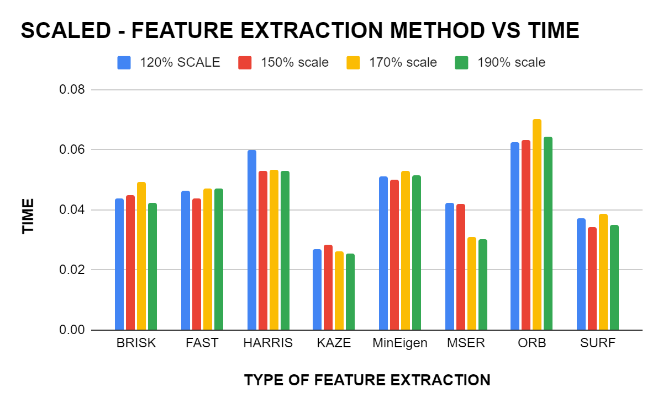
SCALED - FEATURE EXTRACTION METHOD VS TIME
SCALED - FEATURE EXTRACTION METHOD VS TIME
ALGORITHM/SCALED FACTOR | 120% SCALE | 150% scale | 170% scale | 190% scale
BRISK | 0.0439 | 0.04487 | 0.049317 | 0.042299
FAST | 0.046347 | 0.043665 | 0.047194 | 0.047015
HARRIS | 0.059786 | 0.052826 | 0.053238 | 0.053117
KAZE | 0.026761 | 0.028547 | 0.026327 | 0.025562
MinEigen | 0.051124 | 0.049958 | 0.052885 | 0.051355
MSER | 0.042234 | 0.041882 | 0.030799 | 0.030086
ORB | 0.062399 | 0.063155 | 0.070053 | 0.064498
SURF | 0.037279 | 0.034314 | 0.038728 | 0.035153

Slide 14
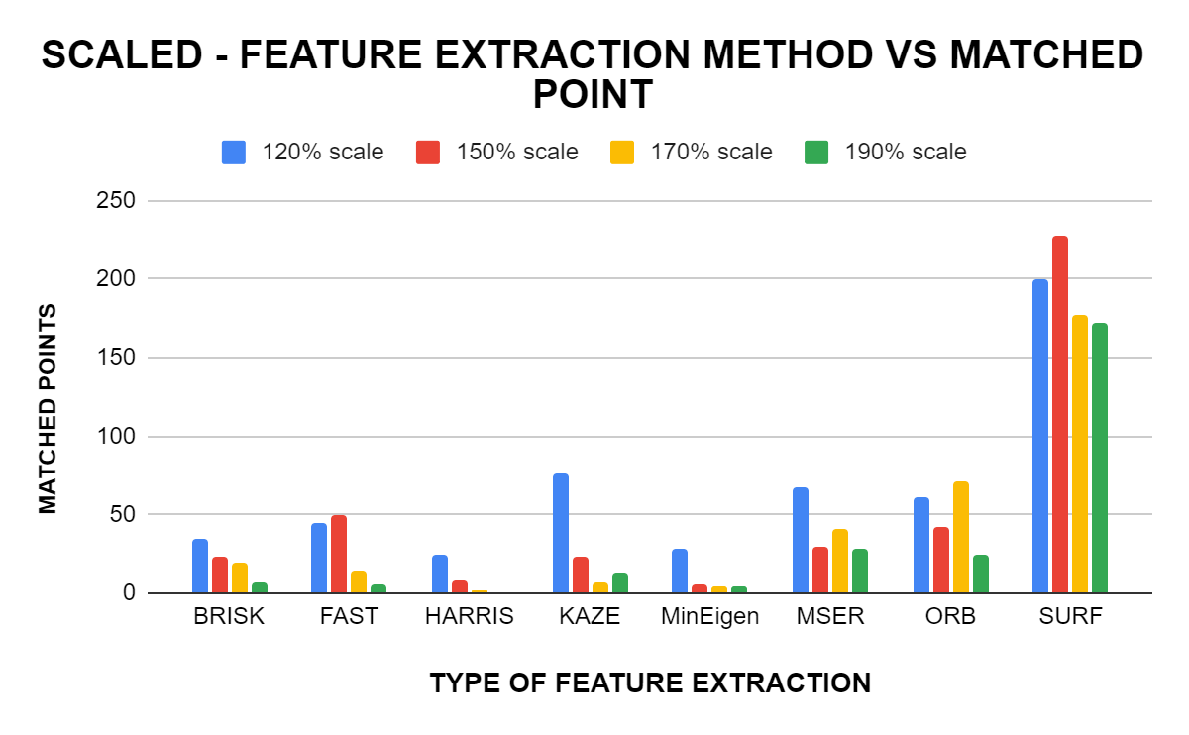
SCALED - FEATURE EXTRACTION METHOD VS MATCHED POINT
SCALED - FEATURE EXTRACTION METHOD VS MATCHED POINT
Algorithm | 120% scale | 150% scale | 170% scale | 190% scale
BRISK | 35 | 23 | 19 | 7
FAST | 45 | 50 | 14 | 6
HARRIS | 25 | 8 | 2 | 0
KAZE | 76 | 23 | 7 | 13
MinEigen | 28 | 5 | 4 | 4
MSER | 67 | 29 | 41 | 28
ORB | 61 | 42 | 71 | 25
SURF | 200 | 228 | 177 | 172

Slide 15
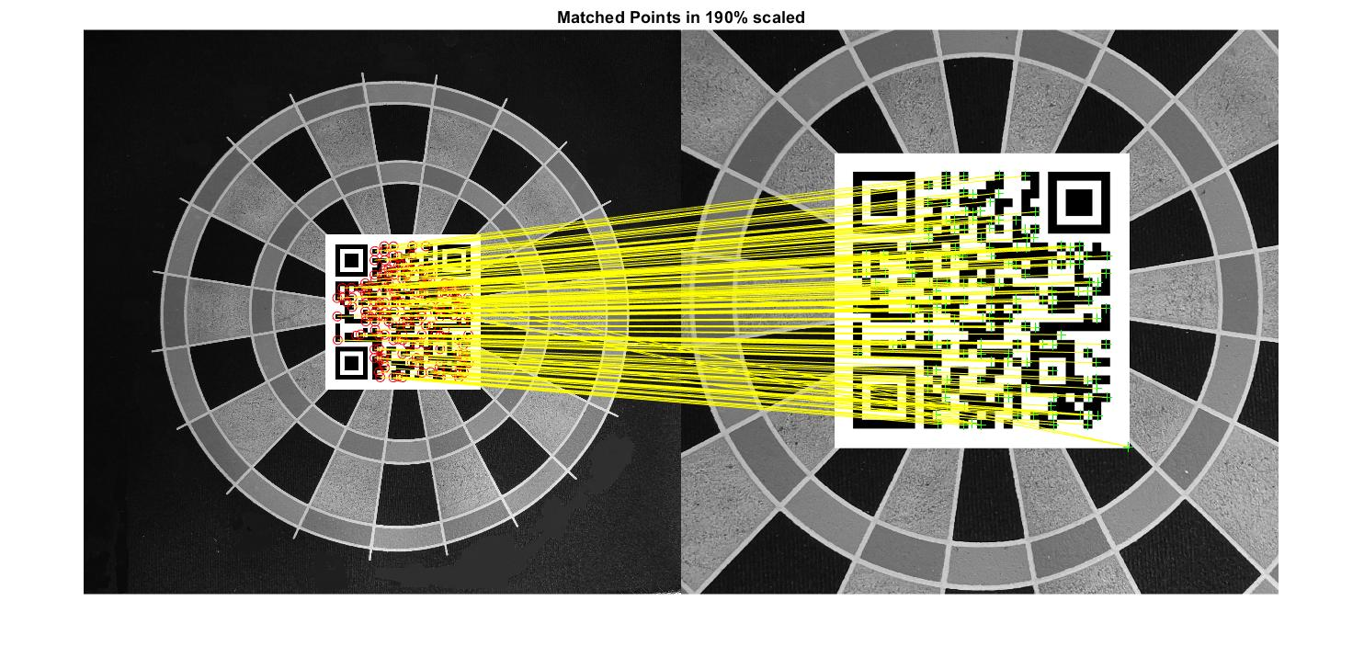
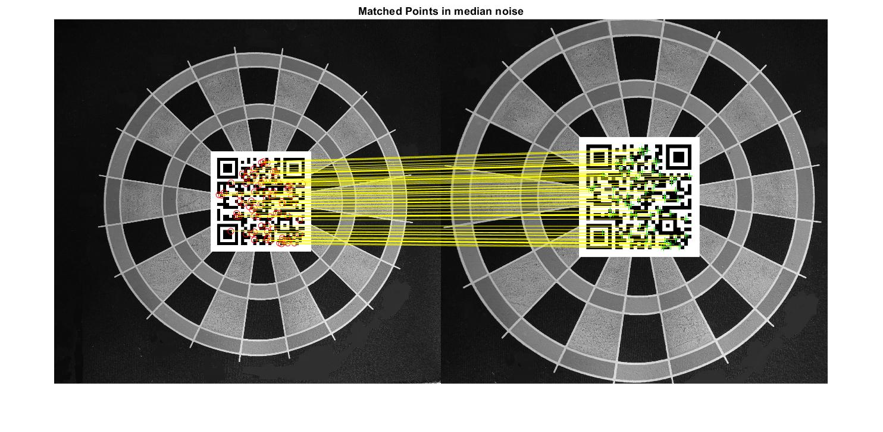
Feature point cross matching using SURF method at a scale of 190%
Feature point cross matching using KAZE method at a scale of 120%

Slide 16
Inference from the data
From the above data and graphs it can be concluded that ,the SURF algorithm performs the best in cases of noise, rotation and scaling with maximum feature points extracted in a relatively minimal time. Brisk is the method that performed moderately well in all of the test scenarios. FAST has the least time for feature extraction and KAZE has the most time among them. ORB performs well in scaled case but at the cost of time.
In the case of noise and scaled condition, SURF outperforms every other method with the highest number of feature points matched with the best time to points matched ratio. Even though KAZE has the least time taken, the number of points matched is way less.
In the case rotation, SURF and MSER performs the best among them with a maximum number of extracted points matched in a relatively less time frame. All the features matched all the points when presented with ZERO degrees tilt.
Therefore,it can be concluded from the above data that SURF feature extraction method is the optimum method for the application

Slide 17
Conclusion
From the experiments conducted based on various factors of distortion in images for the feature extraction techniques available, we concluded that SURF has the highest efficacy with respect to other available feature extraction algorithms.

